Slide 1
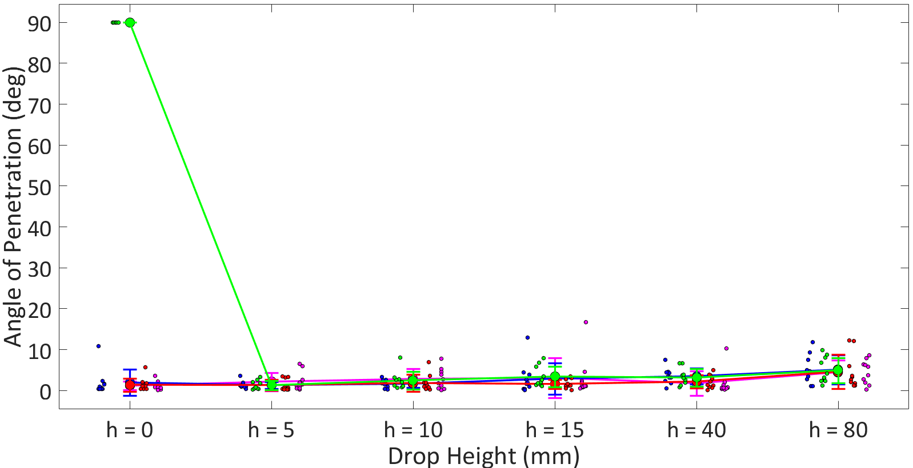
River Sand
Coarse Sand
Mason Sand
Top Soil

